Slide 1



STRING FUNCTIONS IN SNOWFLAKE

Slide 2
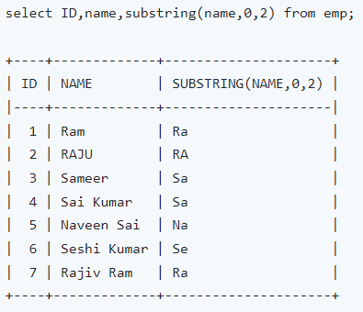
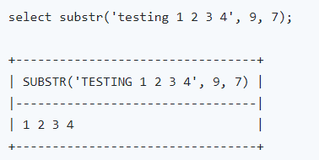
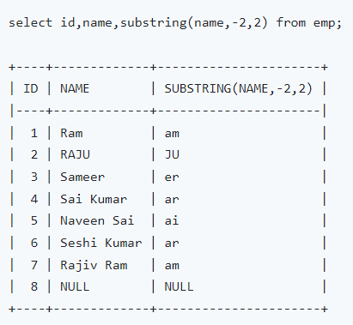
How to use Snowflake Substring Function ?

Slide 3
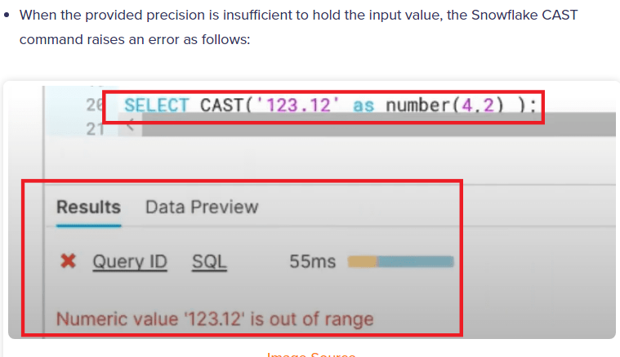
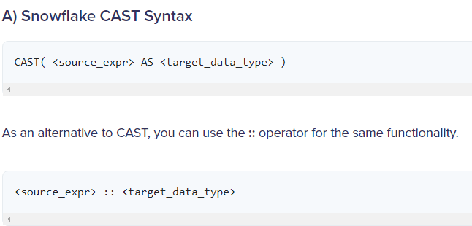
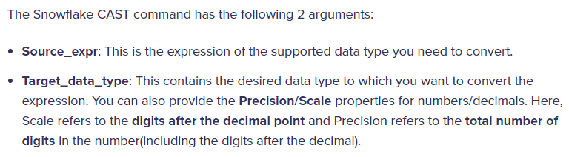
How to use the Snowflake CAST command?
Snowflake CAST is a data-type conversion command. Snowflake CAST works similar to the TO_ datatype conversion functions. If a particular data type conversion is not possible, it raises an error. Let’s understand the Snowflake CAST in detail via the syntax and a few examples.
--Here, precision is set as 4 but the input value has a total of 5 digits, thereby raising the error.

Slide 4
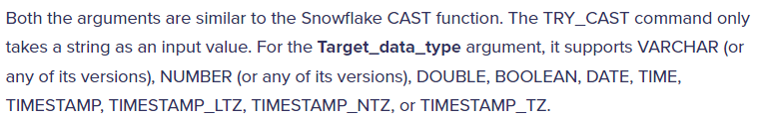
How to use the Snowflake TRY_CAST command?
Snowflake TRY_CAST is a special case of the Snowflake CAST command. It also converts the data type into another, however, it returns a NULL value instead of an error message when the conversion is not possible. Let’s understand the Snowflake TRY_CAST in detail via the syntax and a few examples.
TRY_CAST( <source_string_expr> AS <target_data_type> )

Slide 5
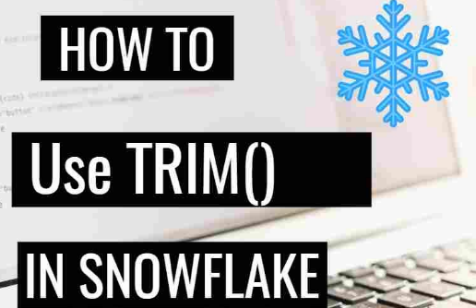
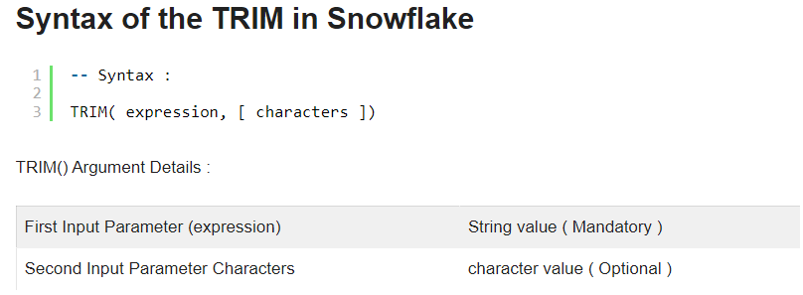
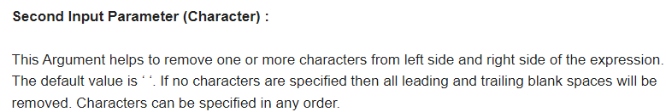
Trim() function is used to remove Leading and Trailing characters from a string. Trim() function consists of two arguments which will be helps to trim the string value.

Slide 6
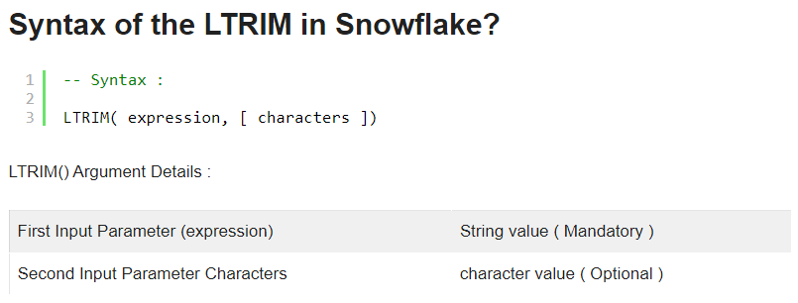
What is LTRIM() Function in Snowflake?
LTrim() function is used to remove Leading characters and also white spaces from a string. LTrim() function consists of two arguments which will be helps to trim the string value.

Slide 7
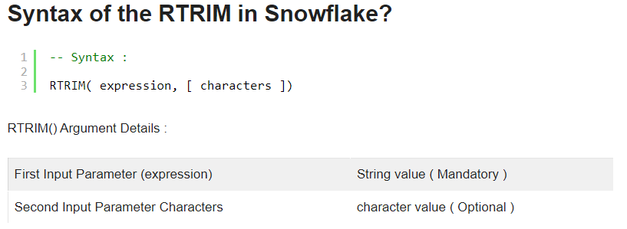
What is RTRIM() Function in Snowflake?
RTrim() function is used to remove Leading characters and also white spaces from a string. RTrim() function consists of two arguments which will be helps to trim the string value.

Slide 8
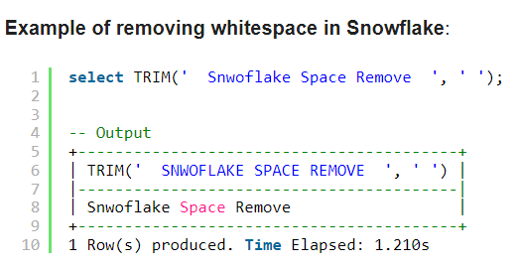
How to remove white spaces from the string in the Snowflake?
To remove the white spaces or the blank spaces from the string TRIM function can be used. It can remove the whitespaces from the start and end both.

Slide 9
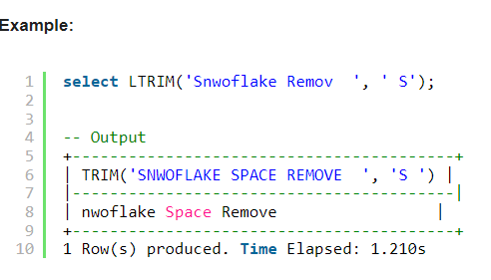
How to remove last character from string in Snowflake?
How to remove first character of string in Snowflake
To remove the first character from the string you can pass the string in the LTRIM function.
To remove the last character from the string you can pass the string in the RTRIM function.

Slide 10
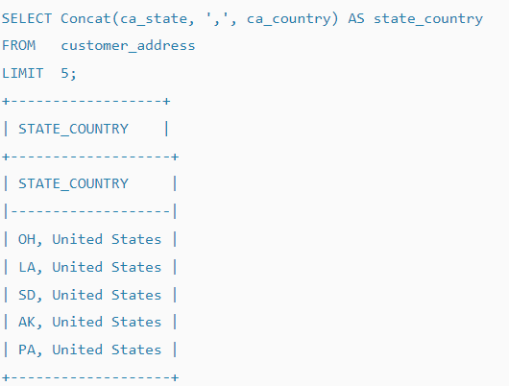

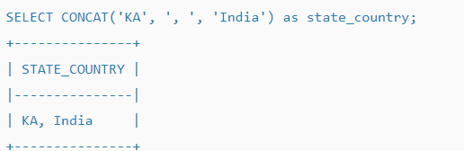
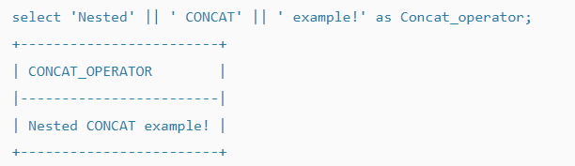
Snowflake Concat Function and Operator – Examples
The CONCAT function in Snowflake concatenates two character strings and returns the resulting string. Note that, If any of the values is null, the result is also null.
Following is the concat function syntax

Slide 11





Thank you..!!

